Slide 1

Semester Project - II
“Cafe Management System”
By
1. Gaurav Borse (231106030 & Roll No: 31)
3. Harshvardhan Desale (231106036 & Roll No: 36)
2. Rohit Solunki (231106022 & Roll No: 23)
4. Lokesh Patil ((231106030 & Roll No: 47)
Under the Guidance of
Prof. P. D. Lanjewar
Department of Artificial Intelligence and Machine Learning
The Shirpur Education Society’s
R. C. Patel Institute of Technology, Shirpur - 425405.
[2024-25]

Slide 2

Outline
Introduction
Features of the System
Project Objectives
System Architecture
Conclusion
References

Slide 3
Problem Statement :
Traditional cafes rely on manual order-taking, leading to:
Order mismanagement
Increased waiting time
Inefficient workflow
Need for a digital solution to streamline operations

Slide 4
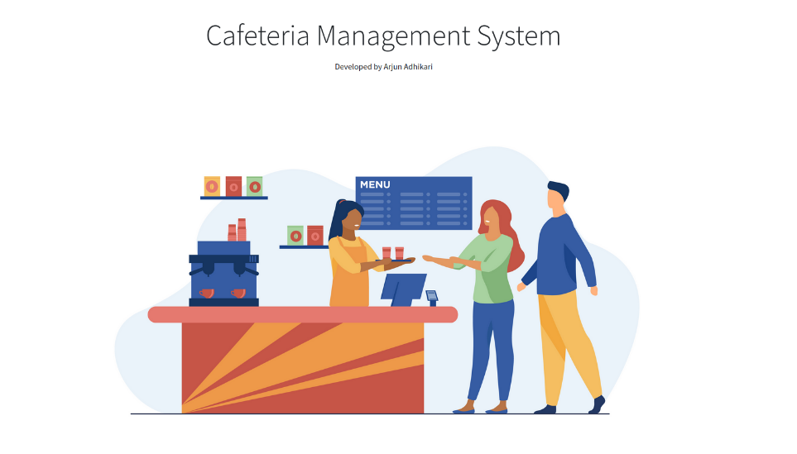
Solution Overview :
Our Cafe Management System enables:
Customers to order food from their table via a website
Orders to be recorded in an Admin Panel for chefs
Efficient food preparation and management

Slide 5

Features of the System :
1. Customer Side
i). Browse menu & place orders
ii). Real-time order tracking
iii). User-friendly interface
2. Admin Panel (Chef/Kitchen Side)
i). View & manage incoming orders
ii). Order status updates
iii). Database management for food items

Slide 6

Project Objectives:
Enhance Customer Experience
Improve Order Management
Increase Efficiency in Cafes
Digital Transformation of Cafes
Scalable & Secure System

Slide 7


Software Requirement:
Frontend Technologies :
Frontend: HTML, CSS, JavaScript
Backend: Django Framework
Database: SQLite
Hosting: Local server
CSS
HTML
JS
BACKEND:

Slide 8
User Flow:
1. Customer visits the website
2. Selects food items & places an order
3. Order details are sent to the admin panel
4. Chef prepares the food
5. Order status is updated and served

Slide 9

Future Enhancements:
Mobile App Development
AI-based Order Recommendation System
Online Payment Integration
Table Reservation Feature
Order Status Tracking for Customers

Slide 10
Conclusion:
Successfully built the frontend using HTML, CSS, and JavaScript.
Integrated Django as the backend framework for managing orders.
Developed the customer order system, where customers can place orders from their tables.
Orders are now being recorded in the Admin Panel for chefs to prepare food.

Slide 11
References:
Technologies & Documentation:
Django Documentation: https://docs.djangoproject.com/
HTML, CSS, JavaScript: https://developer.mozilla.org/
Bootstrap : https://getbootstrap.com/
Inspiration & Research:
Cafe Management Systems & Digital Ordering Trends
Online tutorials & development blogs

Slide 12


